Slide 1
ANGLICAN PARISH OF GISBORNE
FUTURE DIRECTIONS – STRATEGIC PROPERTY REVIEW

Slide 2
PROJECT GOALS
PARISH GROWTH
To utilize the parish assets to generate resources to grow the Parish, via increased community engagement and support.
PARISH REVENUE
To establish an additional and secure income stream to offset the reliance on Op Shop revenue and to supplement parish giving and fundraising.
PARISH ASSETS
To reduce the current and anticipated maintenance and capital renewal costs associated with Parish property assets.

Slide 3
PROJECT PROGRESS
1. Preliminary Discussion with Diocese – December 2020
2. Finalised Project Brief – April -May 2021
3. Appointed Consultants - June 2021
4. Site Investigation Reports prepared – August 2021
5.Strategic Property Review Report – September 2021
6. Currently considering options and recommendations
7. Aim to present to Parish Council – October and to the Annual Parish Meeting in November 2021.

Slide 4
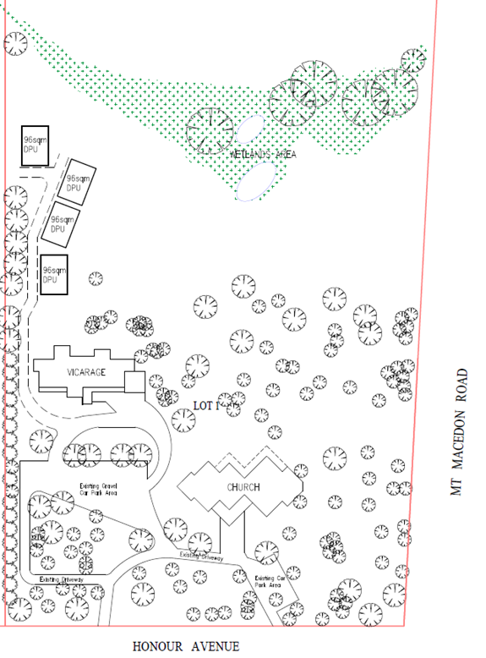
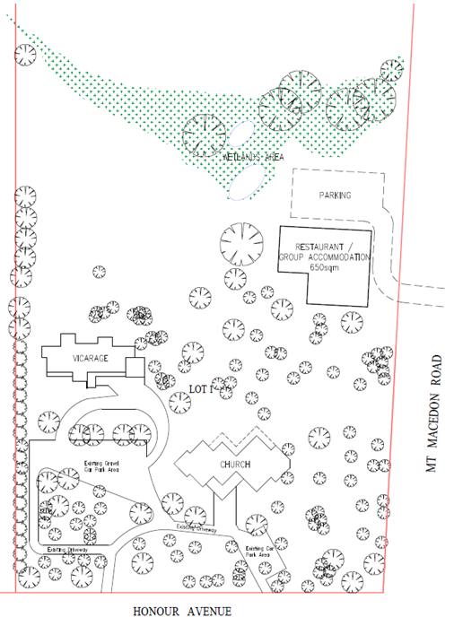
6 Honour Avenue (Church and Vicarage)

Slide 5
SITE INVESTIGATION MACEDON
6 Honour Avenue (Church and Vicarage)
The property has some development potential, however due to conservation overlays and current planning zone, a development proposal will require greater lead-in time to plan and implement.
The recent use of the land for the Autumn Festival Car Park is adding to Parish revenue, community engagement and responding to a presenting community need.
Recommend that the property is retained and seen as having medium to longer-term development potential.

Slide 6
SITE INVESTIGATION GISBORNE

Slide 7
32 Fisher Street (Church Site) & 32 A Fisher Street (Parish Centre)

Slide 8
SITE INVESTIGATION GISBORNE
32 Fisher Street (Church Site)
The integrity of the vistas to the Church and surrounds are listed as significant and need to be protected.
The land to north of the Church has some potential for development, however the topography of the land presents challenges.
Retain the site in the current state, noting that development could be revisited in the medium to longer term.
32 A Fisher Street (Parish Centre)
The Parish Centre is in reasonable condition and currently accommodates Parish Administration as well as providing flexible meeting/activity spaces.
Some improvement/upgrades could be made if funds are available, however functional for next 5years.
Retain the facility for the foreseeable future.

Slide 9
SITE INVESTIGATION GISBORNE
30 Fisher Street (Hall site).
The Hall is not fit for purpose for the current uses and is in a deteriorated state. An estimated $300K + is required to upgrade and to meet some of the contemporary standards for community-use facilities.
The site has the greatest capital return/development value and strong potential for revenue generation.
The site has capacity for a multi level development.
Proposal
Relocate the Op Shop to a premises in the Town Centre (Shopping precinct).
Find alternate, nearby premises to accommodate the Children’s ministry programs. E.g., other community space that is for hire.
Invite an EOI from suitable organizations to Partner with the Parish to develop the whole site with facilities that provide accommodation for commercial/community services that are permissible within the planning zone. E.g., medical, education services. The Parish to contribute the land to the development and post development, retain an interest in the property. This interest to be leased and generate a reliable revenue stream.
Additional revenue has potential to fund resources to support Parish Mission including; community outreach/engagement /support and to build the congregation.

Slide 10
30 Fisher Street (Hall site).

Slide 11
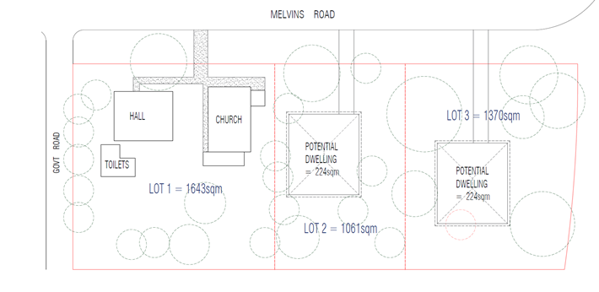
1-7 Melvins Road. (Church and Hall)

Slide 12
SITE INVESTIGATION RIDDELLS CREEK
1-7 Melvins Road. (Church and Hall)
Vacant land to the north and west is underutilized and has the potential to be developed, subdivided and sold.
The parishioner attendance and current facility utilization is very low.
Condition of Church and Hall is deteriorating and will require investment to maintain functionality and meet OHS standards in the short to medium term.
Options
Close the Church and prepare the whole site for sale and secure development approval to subdivide to maximize capital return. OR
Retain Church and Hall and prepare a development proposal to subdivide the balance of the land for sale.
If option ii is selected it is recommended that resources are committed to growing the congregation and increase the facilities utilization levels.
It was noted that the land is used by some community members as an access to the creek reserve and open space to the rear of the property. Explore interest of MRSC to consider land purchase to augment the current open space.
Note that the Memorial Gardens adjoining the Church will need to be relocated.

Slide 13
SITE INVESTIGATION RIDDELLS CREEK
1/8 Station Street. (Op Shop)
The Op Shop is accommodated and well supported in this location, providing an effective community outreach and a Parish profile to the small community which is projected to grow.
The shop has potential for another level to be constructed.
Retain the premises and consider the potential to develop an upper level in the medium to long term.

Slide 14
PROPOSALS
6 Honour Avenue, Macedon (Church and Vicarage)
Recommend that the property is retained and seen as having medium to longer-term development potential.
32 Fisher Street, Gisborne (Church Site)
Retain the site in the current state, noting that development could be revisited in the medium to longer term.
32 A Fisher Street , Gisborne (Parish Centre)
Retain the facility for current uses, for the foreseeable future and consider some improvements, (funds permitting)
30 Fisher Street, Gisborne (Hall site).
Relocate the Op Shop to a premises in the Town Centre (Shopping precinct).
Find alternate, nearby premises to accommodate the Children’s ministry programs. E.g., other community space that is for hire.
Invite an EOI from suitable organizations to Partner with the Parish to develop the whole site with facilities that provide accommodation for commercial/community services that are permissible within the planning zone. E.g., medical, education services. The Parish to contribute the land to the development and post development, retain an interest in the property. This interest to be leased and generate a reliable revenue stream.
1-7 Melvins Road, Riddells Creek. (Church and Hall)
Close the Church and prepare the whole site for sale and secure development approval to subdivide to maximize capital return. OR
Retain Church and Hall and prepare a development proposal to subdivide the balance of the land for sale.
1/8 Station Street, Riddells Creek. (Op Shop)
Retain the premises and consider the potential to develop an upper level in the medium to long term.

Slide 15
Where have we come from ?
2017 Strategic Plan
Leading Your Church into Growth – LYCiG program
Mission Action Plan 2018-2021 – now due for review
2021 Pandemic crisis
Options are:
Try to return to pre Covid state.
Take as an opportunity to reinvent.
Reframe – what can we learn and adapt.
Release resources for alternative ministry.

Slide 16
Living Our Faith
“For surely I know the plans I have for you, says the Lord,
Plans for your welfare and not for harm,
To give you a future with hope”.
Ref; Jerimiah 29:11

Slide 17
Reimagining the Future
Be a compelling and outward looking Christian presence in our community.
Reach across boundaries of human division to serve our community and proclaim Christ.
Be open to the Holy Spirit in transforming lives to be mature in Christ.
Use all the energy that God powerfully inspires to better manage our human and capital resources.
Ref: Anglican Diocese of Melbourne-Strategic Directions.

Slide 18
A compelling and outward looking Christian presence
What is our current presence in the Community;
3 worship Centres,
8 worshipping congregations (3 currently in recess due to COVID)
2 Op Shops
3 Playgroups

Slide 19
Reach across boundaries of Human division.
Current Parish Activities;
Outreach to older citizens through the delivery of services to Residential Aged care.
Volunteer support into Older Citizens via Benetas and Warrina.
Support to the LLEN program
Support to AA
Support to Foodbank
Active Children’s ministry associated with the Playgroups
Material aid and environmental recycling via the Op Shops
Animal welfare initiatives.

Slide 20
Transforming lives to be mature in Christ.
EfM – Exploring Faith Matters
KyBfM – Know your Bible for Men
Adult Bible Studies
Curacy and Training – Field Committees (currently 2)
Messy Church
Community Led services – Carols, All Souls Day, Easter and Anzac Day
Inter Church Fellowship

Slide 21
Better manage our human and capital resources.
Unlocking our resources for Ministry – both physical resources and human resources.
Utilizing the talents of All – Clergy, Staff team and Parishioners.
E.g., Cooking, photography, craft, music, Teachers and Pastors.
Reframing the existing property and people resources to strengthen ministry to the lower Macedon Ranges.
Transforming the property assets into active ministry opportunities.

